Slide 1
RESILIENT COMPANION · PROJECT BRIEF
THEME · RESILIENCE
AN OFFLINE-FIRST AI APP
keep
going
Resilient AI
LifeKeeper.
Your everyday journal and your emergency network rolled into one. It keeps ideas, thoughts, and daily logs safe — and when disaster strikes it becomes a lifeline, even with no internet, no problem.
MODE · A
Daily Mode
MODE · B
Emergency Mode
Power Profile
Daily draws more. Emergency draws less.
A WALKTHROUGH OF CONCEPT, CAPABILITY, AND A HOSPITAL EARTHQUAKE
COVER

Slide 2
THE BRIEF
CONCEPT + WHY
Keep living, keep
remembering, keep
recovering.
WHY THIS EXISTS
Every phone already carries the tools to save a thought and to save a life. Most days it is not asked to do either.
Resilience is built long before the disaster.
IN ONE SENTENCE
A local-first AI app that captures daily life daily, supports you through emergencies daily, and reconnects cleanly when the world comes back online.
Daily Life
Disaster
Recovery
Capture ideas. Reflect. Organize. Search everything, even offline.
Log incidents, supplies, triage. Chat peer-to-peer. Get AI guidance.
Encrypted local-first storage. Sync with conflict resolution when net returns.

Slide 3
ANATOMY OF THE APP
FIVE MODULES
5
Five modules that compose one companion.
Modules, One Device
01
02
03
Daily
Life Logs
Disaster
Logs
Offline Chat
Journaling. Idea capture. AI sorts entries into work, personal, creative. A searchable offline knowledge base.
Supplies, casualties, incidents, triage notes. AI summarises for situational awareness when seconds matter.
Peer-to-peer messaging without internet. The AI joins the room to provide guidance and reminders, even mid-blackout.
04
05
AI Companion
Resilient Sync
Summarises daily logs (“here are your top three ideas today”). Provides morale support in emergencies. Suggests triage priorities and next steps.
Auto-syncs when the internet returns. Conflict resolution via CRDTs and vector clocks, so nothing gets lost even if many people edited offline at once.
EACH MODULE SHIPS WITH THE DAILY BUILD. EACH MODULE IS CRITICAL DURING THE WORST DAY.

Slide 4
MODE · A
FOR EVERYDAY
WHAT IT DOES FOR YOU ON A QUIET DAY
Keeps your thinking in shape. Keeps your day searchable.
Daily.
1
Capture & journal offline
Higher draw. Bigger AI. Built for the days you have in body.
Type, voice, sketch. Save entries even on a cramped subway with no signal.
2
Auto-categorise & summarise
AI splits entries into work, personal, and creative. At day’s end you get a recap.
3
Search the offline knowledge base
Find that one idea from three Tuesdays ago, in milliseconds, in a tunnel.
Tue · Today, in Summary
DESIGNED FOR
POWER PROFILE
Writers, founders, students, researchers, care-givers, anyone whose thoughts matter more than their connection.
~100%
“Three big ideas, two reflections, one unfinished sketch. Tap to revisit.”
Background sync on. Foreground AI on. Notifications on.

Slide 5
MODE · B
FOR THE WORST DAY
WHAT IT DOES FOR YOU ON A BROKEN DAY
Logs the facts. Keeps the room talking. Keeps you okay.
B MODE
Emer-
gency.
Log incidents, supplies, triage,
casualties
Peer-to-peer chat without towers
Tag a record in a few taps. AI summarises the whole field on demand.
Mesh through other phones. Buildings, basements, blackout — still reachable.
AI suggestions on triage priorities
Morale: a small steady voice
Lower draw. Tighter AI. Built for the days you have to keep.
Pulls from your logs and surfaces the next step you should consider first.
Quiet reminders. Breathing pauses. Permission to keep going one more step.
The AI is patient. The model is local. Battery is conserved. Every tap is one-handed. Nothing requires a thought you do not have.
POWER PROFILE
~40%
Background sync paused. Smaller model. Screen brightness clamped. Mesh radio kept warm.
AUTO-ENGAGES WHEN MOTION + SIGNAL LOSS EXCEEDS A THRESHOLD. MANUAL TOGGLE IN ONE SWIPE.

Slide 6
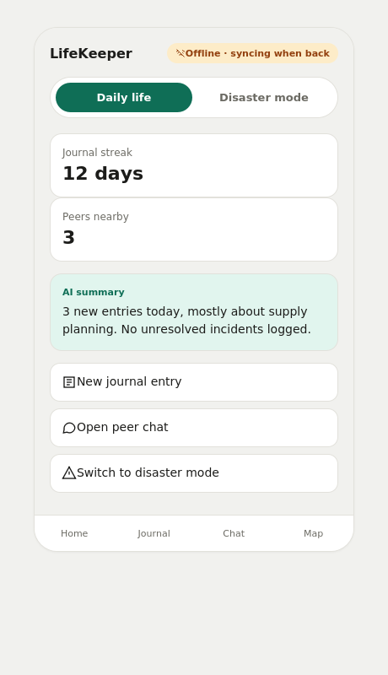
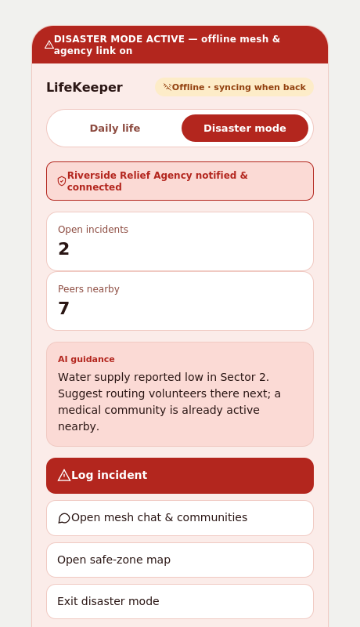
THE APP
DAILY VS. DISASTER ZONE
Same app. Two zones, colour-coded so you always know which one you're in.
DAILY ZONE
DISASTER ZONE
Mode toggle at the top of every
screen — the whole UI recolours
the instant you switch, so the
zone you're in is never in doubt.
#0F6E56
#B3261E
COLOURS PULLED DIRECTLY FROM THE UI MOCKUP — DAILY TEAL, DISASTER RED.

Slide 7
TWO ENGINES, ONE DEVICE
COMPARISON
The same app. Two personalities. One slider
apart.
Daily mode spends power to give you a richer AI and full sync. Emergency mode spends the same hour differently — it saves power, conserves screen, and keeps the mesh radio alive while everything else goes dark.
MODE A
MODE B
HOUR 6 OF A BLACKOUT
Daily
Emergency
Same battery, very
different morning.
~100%
~40%
Daily
Reference power draw
Conservative draw
60% remaining
+ Full background sync on
+ Larger model, richer summaries
+ Notifications + reminders on
– Background sync paused
– Smaller model, tighter answers
+ Mesh radio held warm
Emer.
88% remaining
Same phone. Same disaster. +28% battery at the moment you need it most.
Best: power, signal, calm
Best: lost signal, lost hours, lost power
DRAW FIGURES ARE REFERENCE. TOGGLING IS ONE SWIPE; AUTO-TRIGGER WHEN SIGNAL & MOTION SHIFT.

Slide 8
UNDER THE HOOD
RESILIENT SYNC
Layer 1
Layer 2
Layer 3
ARCHITECTURE
Local store
Local AI
Mesh layer
Offline
first.
Reconcile
after.
Every entry lives on-device first. Reads, writes, and search work without a server.
A small model summarises, classifies, and prompts. No round trip. No latency tax.
Phones become relays. Wi-Fi Direct + Bluetooth LE carry peer chat and logs.
Layer 4 · The Reconciler
Layer 5
CRDTs & vector clocks
Sync, when ready
When many devices edit offline and reconnect, conflicts resolve without losing anyone’s truth. Two nurses logging the same patient at once both survive.
Auto-sync once connectivity stabilises. Before/after allowed. Delta-only payloads.
TYPICAL LIFECYCLE OF A DISASTER LOG
A device is never down because the network is. The cloud is invited later; it is never the boss.
Capture → Merge → Summarise → Surface → Sync
Each arrow is local if it can be. Each step has a fallback. A 30-second capture still survives a 30-hour blackout.
TRUST THE ORDER
Local log → peer merge → eventual cloud sync.
EACH LAYER OPTIONAL. THE SYSTEM SURVIVES ANY SINGLE LAYER FAILING.

Slide 9
TRUST
PRIVACY & SECURITY
You hold the key. The phone holds the
weight.
E2E
End-to-End
A thought kept offline is not a thought owed to anyone. A disaster log kept on-device is not a log that can be subpoenaed across borders by accident.
Principle 1
Principle 2
Principle 3
Local-first encryption
Peer channels stay peer-only
A wipe you control
Every entry is encrypted on the device before it ever leaves. Personal logs and disaster logs live behind the same key, on the same hardware.
Mesh messages between phones are encrypted at the session layer. No provider sees them, even if every relay was hostile.
One tap erases the personal layer. One separate tap erases the disaster layer. One tap erases everything. You choose how thin your trail stays.
ENCRYPTION IS THE DEFAULT. PRIVACY IS THE ARCHITECTURE, NOT A FEATURE.

Slide 10
A Walkthrough · Assumed Scenario, Illustrative
An Earthquake. A Hospital. Four
Hours.
06:14
SIMULATION
A hospital, an
earthquake, and the
app on every phone.
Daytime · Occupancy High · Connectivity Lost Within Seconds
THE SCENARIO WE ASSUME
MAP OF THE NEXT SIX HOURS
A 12-floor regional hospital on a Wednesday morning. Rangebound tremor cuts grid power, knocks out two cellular towers, and floods the ER waiting area. Staff, patients, and visitors each carry a personal phone. Each phone holds LifeKeeper.
We will visit four moments, T+0 to T+6h. At each, the app is somewhere different. Battery, signal, mode, rooms filled with people — all of it changes. Watch what the app is doing when its owner’s hands are full.
Continue to the First Phase
T+0 · T+15 MIN · T+90 MIN · T+6 H

Slide 11
Phase 1 of 4
Battery
Connectivity
Phones in Mesh
T + 0
Mode · Auto-Switched to
Emergency
Tower lost · mesh warming
02 / 12
Full · 100%
WHAT IS HAPPENING
WHAT LIFEKEEPER IS DOING, IN THE FIRST 60 SECONDS
A shake. Lights out.
A long, loud
second.
Switching modes. Listening. Logging.
Auto-engages emergency mode
Detects sustained motion + signal drop. Switches within seconds. No prompt, no settings.
Ceiling tiles rattle, monitors flicker, the elevator dings open and stays open. People stand up too fast. A nurse behind the reception desk grabs a phone. Within eight seconds, three other phones across the floor also go bright.
Pre-creates incident log
A blank “Earthquake, T+0, Floor 3” entry waits for the first tap. Time stamped automatically.
Mesh radio warms
Two phones already on the same floor discover each other over Bluetooth LE. One becomes a relay.
Sync paused, freshness prioritised
Cellular radio goes quiet. Local writes only. Battery conserved for the long hours ahead.
FIRST LOG ENTRIES, T+0:04 TO T+0:38
FLOOR 3, TWELVE PHONES
T+0:04 Reception · ceiling panels down, one window cracked.
T+0:11 Hallway B · IV stand toppled, two patients on the floor.
T+0:22 Stairwell · intercom dead. Backup lights on.
T+0:38 ER anteroom · three visitors brought in, minor injuries.
■ In mesh, syncing
■ Relay, hosting the room
■ Discoverable, not yet joined
Mesh grows over the next 14 minutes.
T+0 OF 4 PHASES · CUMULATIVE SCENARIO, ILLUSTRATIVE

Slide 12
Phase 2 of 4
Battery
Connectivity
Logs In Flight
T + 15'
Mode · Emergency Mode
Mesh live · 8 of 12 joining
07 entries
~98% · 2% on radio
WHAT IS HAPPENING
Peer Chat · Floor 2 · 4 In Room
The corridor fills.
The phones start
talking.
One room, one thread, one source of truth.
Dr. Patel · 2 min ago
Stairwell B is the safe zone. Send walking wounded here.
Walking wounded arrive from the upper floors. A doctor on the second floor takes over the stairwell as a triage zone. Three visitors ask for water. The phones in that room cluster together as one “Floor 2” channel.
AI Companion · 1 min ago
Three water bottles logged low. Should I draft a checklist?
V. Rao, visitor · just now: My mother is on Floor 4. Can someone say if it's safe to go up?
In Every Thread, Every Minute · The Same Quiet Companion
A small steady voice says:
AI IS SUGGESTING · IN THE ROOM RIGHT NOW
Triage prompts · ordered by urgency
“You have done enough in the last 15 minutes. Take one breath. Then choose the next small thing.”
Confirm airway, breathing, circulation · marked urgent by Dr. Patel, 2 min ago
Tag two visitors with minor injuries in ER anteroom · 5 min ago
Auto-delivered every 8 minutes · never a notification when hands are full
Run supply check: water, gauze, ibuprofen · 8 min ago

Slide 13
Phase 3 of 4
Battery
Status
Logs Captured
T + 90'
Mode · Still Emergency
Mesh stable · 11 of 12 joined
14 entries
83% · manageable
STABILISING
The room gets quieter. The logs get denser.
Morning rounds begin — a slower tempo. Nurses use the app to count supplies, tag new arrivals, and let the AI draft a status note that any other floor can read when it joins the mesh.
SUPPLY TRACKER · LIVE, AI-ASSISTED
AI SUMMARY · 90 MINUTES IN
What we have and how fast it leaves.
Floor 1: stable, mostly cleared by 11:00.
Floor 2: 6 walking wounded, 2 unaccompanied. Send another doctor.
Floor 3: stairwell B holding 11, water running low by 12:30 at this rate.
Floor 4: structural crack noted, 3 staff choosing to stay with patients.
Across floors: saline is the bottleneck.
Drinking water
~30% left
Gauze & bandages
~62% left
Ibuprofen
~22% left
Flashlights
~55% left
Saline bags
~14% left
Send a copy of this to the next floor

Slide 14
Phase 4 of 4
Battery
Status
Conflicts Resolved
T + 6h
Mode · Emergency, Sync
Retrying
Tower back · sync retrying
04 / 04
~58% · held by
Emergency
RECONNECTING
SYNC ENGINE · THE RECONCILER AT WORK
One tower comes back.
The mesh goes
quiet.
Three devices, three truths,
one merged record.
Around hour five, one cell tower returns at low strength. The app stops trying to relay. Cloud sync begins quietly in the background. It does not interrupt the work; it catches up the work.
81% synced · 4 conflicts merged · 0 lost
IN ONE LINE, FROM THE AI
“You kept each other recorded.
The network caught up with you,
not the other way around.”
WHAT RECOVERY LOOKS LIKE
Logs survive. Voices survive.
The day survives.
01 A 30-second entry about a cracked window still says “cracked window”.
02 Two nurses who tagged the same patient keep their own notes. Both stay.
03 A visitor who asked about her mother is still reachable on the same thread.
Encrypted on every device. Reconciled, never overwritten.
Returned to daily mode when connectivity & motion normalise

Slide 15
WHERE IT LANDS & WHO CARRIES IT
TEAM · IMPACT
Five people.
Five
places it has to matter.
THE TEAM
WHERE IT LANDS
Dhruv
Five places where resilience stops being
abstract.
BACKEND & SYNC ENGINEER
Peer-to-peer sync, CRDTs, log storage.
Prateek
01
Daily life · journaling, idea capture, offline productivity.
AI DEVELOPER
Offline AI for daily + disaster summarisation.
02
Disaster zones · relief workers coordinate without internet.
Taksheel
FRONTEND UI / UX DESIGNER
UX for journaling, chat, and dashboard.
03
Healthcare emergencies · offline patient triage and AI support.
Namit
CYBERSECURITY SPECIALIST
04
Community resilience · neighbours share info during blackouts.
Encryption, secure peer-to-peer comms.
Yuvraj
05
Critical infrastructure · outage logs synced locally first.
DEMO LEAD
Walks the demo path end-to-end.

